Slide 1
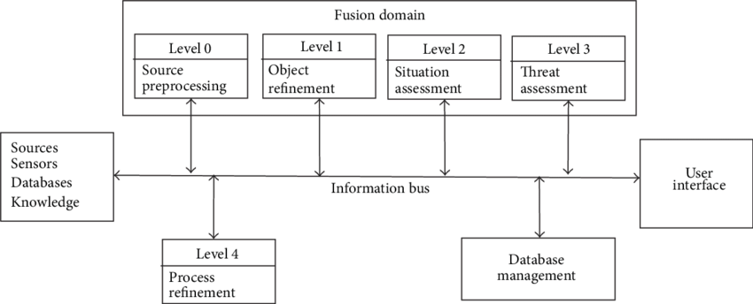

Fusion Domain
Sensors Selection
Sensor Awareness
Data Analysis
Manhattan Distance
StudentLife Dataset
Terminal
Sensitive Analysis

